Slide 1
Zoom Games – Embrace the Chaos
Sarah Johnson, Ethan Kohrt, Jake LaMotte, Boone Tison

Slide 2
introduction
Zoom game
Short game with 3+ people
Mafia
Java
Boone

Slide 3
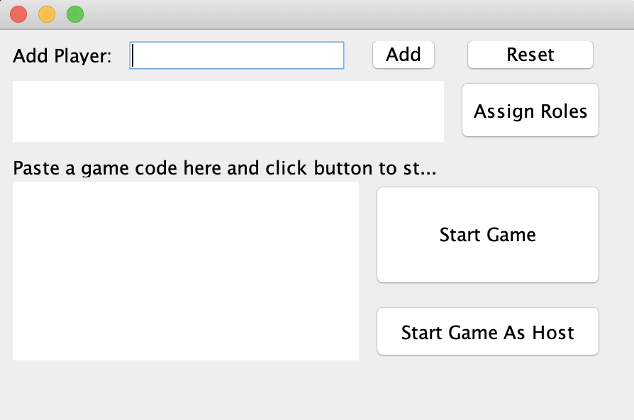
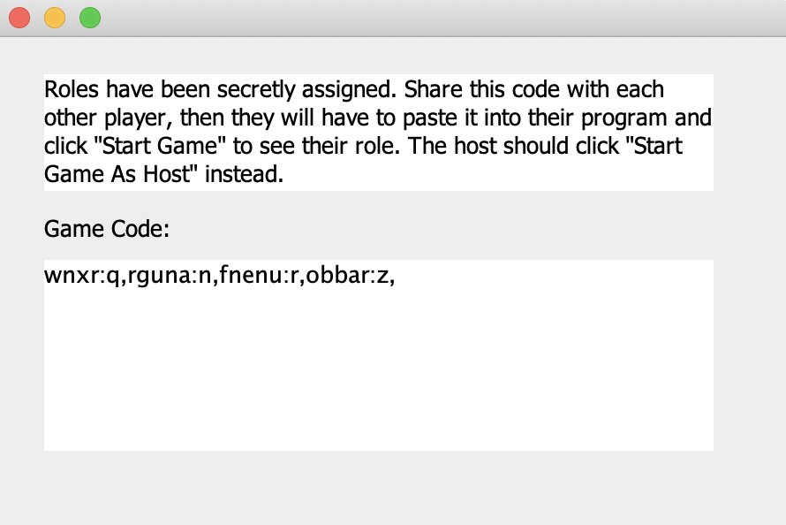
Prototype
Ethan

Slide 4
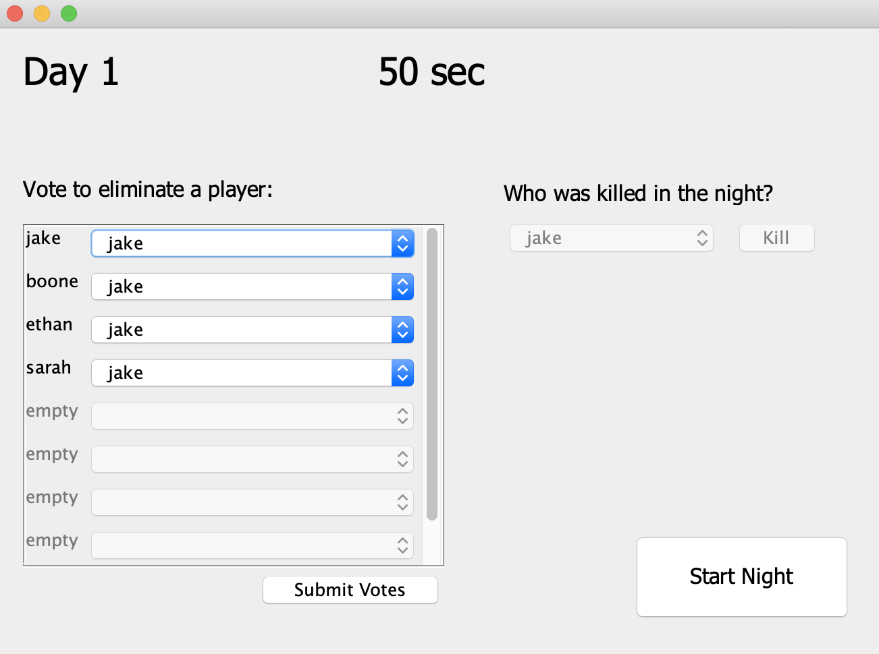
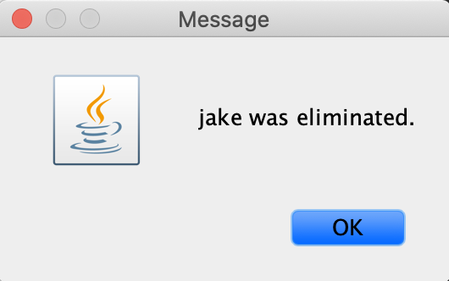
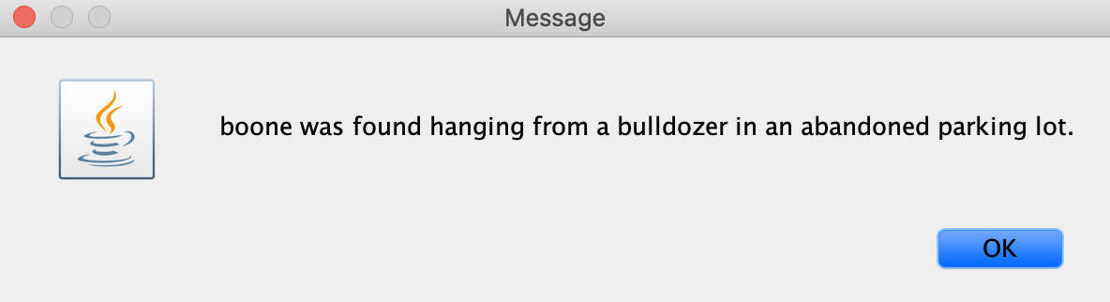
Prototype
Ethan

Slide 5
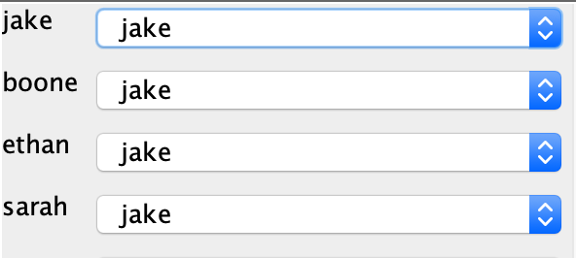
Heuristic evaluation
Tutorial or Instructions
#1 – Visibility of system status
#2 – Match between system and real world
#10 – Help and documentation
Default voting selection
#5 – Error prevention
#7 – Flexibility and efficiency of use
Sarah

Slide 6
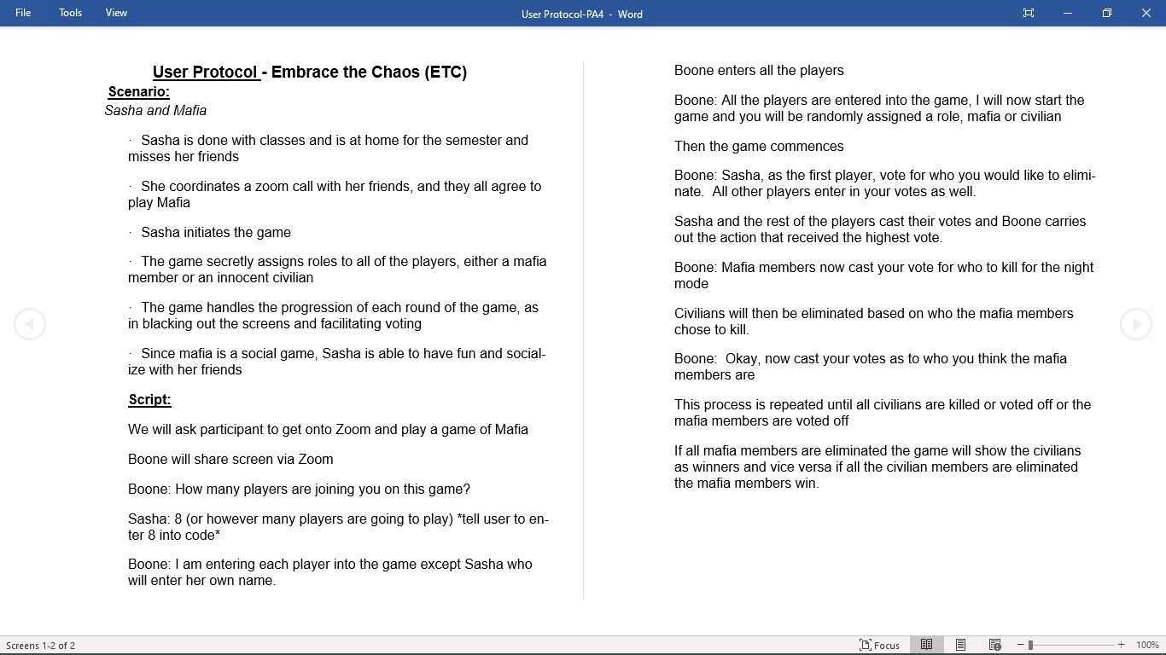
User evaluation
Scenario – Socializing via Zoom
User Evaluation
Single user playing with us
Host running game and sharing screen
Enjoyment levels
Functionality
Jake

